Slide 1
Class
Class is a group of objects that share common properties and relationships.
Generally a class specification has two parts:-
a) Class declaration
b) Class function definition

Slide 2
Class declaration
Syntax:-
class class-name
{
private:
variable declarations;
function declaration ;
public:
variable declarations;
function declaration;
};

Slide 3
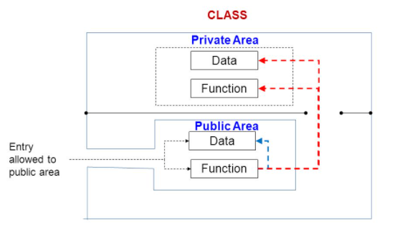

Slide 4
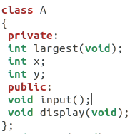
Class declaration example

Slide 5
DEFINING MEMBER FUNCTION:
Member can be defined in two places
Outside the class definition
Inside the class function

Slide 6
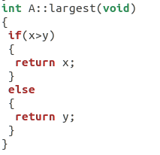
Outside the class definition
Syntax:
return type class-name::fun-name(argument declaration )
{
function-body
}
ex.

Slide 7
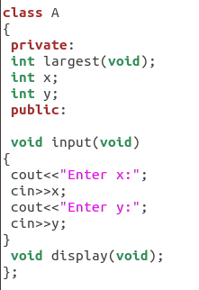
Inside the class declaration

Slide 8
CREATING OBJECTS:
Once a class has been declared we can create variables of that type by using the class name.
Example: A obj;

Slide 9
ACCESSING CLASS MEMBER:
The private data of a class can be accessed only through the member functions of that class.
Syntax(for public members):
object_name.function-name(arguments);
Example:- obj1.input();

Slide 10
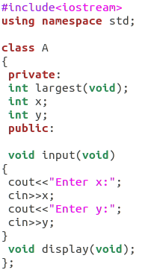
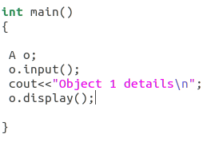
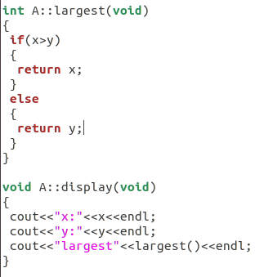
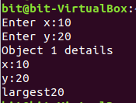
Class Implementation

Slide 11
Private member functions:
A private member function can only be called by another function that is a member of its class. Even an object can not invoke a private function using the dot operator.

Slide 12
STATIC DATA MEMBER:
A static member variable has contained special characteristics.
It is initialized to zero when the first object of its class is created. No other initialization is permitted.
Only one copy of that member is created for the entire class and is shared by all the objects of that class, no matter how many objects are created.

Slide 13
For example a static data member can be used as a counter that records the occurrence of all the objects.
int item :: count; // definition of static data member
Note. The type and scope of each static member variable must be defined outside the class definition .

Slide 14
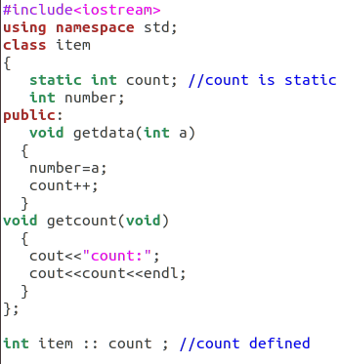
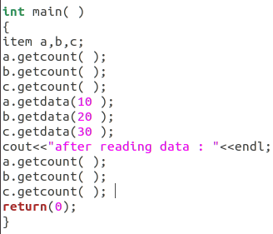
Ex.

Slide 15
STATIC MEMBER FUNCTIONS:-
A member function that is declared static has following properties :-
A static function can have access to only other static members declared in the same class.
A static member function can be called using the class name as follows:-
class - name :: function - name;

Slide 16
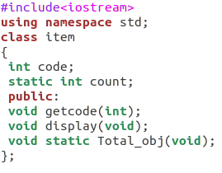
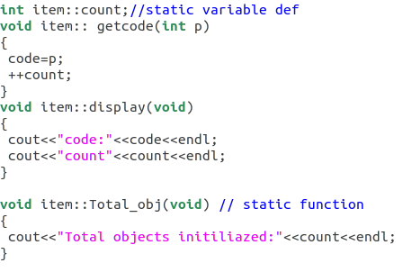

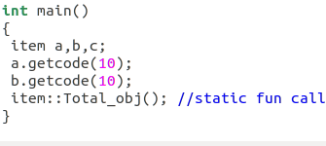

Slide 17
Objects as function arguments
An object may be used as A function argument. This can done in two ways
A copy of the entire object is passed to the function. (pass by value)
Only the address of the object is transferred to the function. (pass by reference)

Slide 18
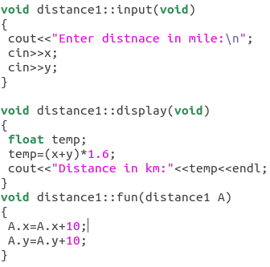
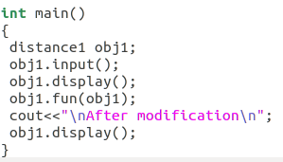
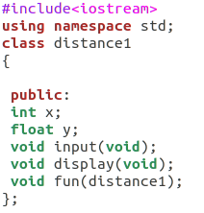
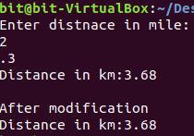
Pass by value

Slide 19
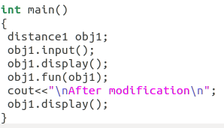
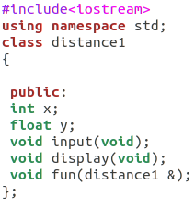
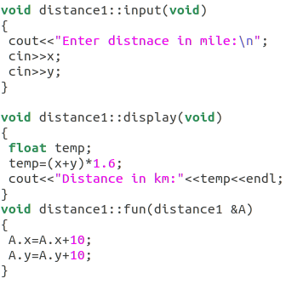
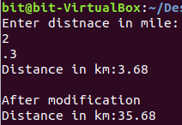
Pass by reference

Slide 20
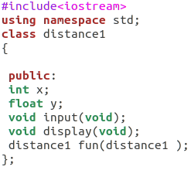
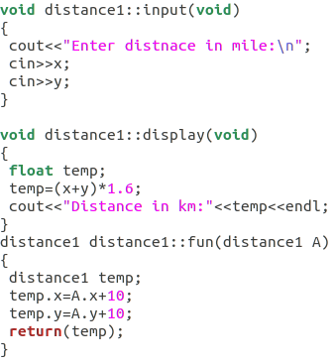
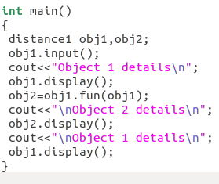
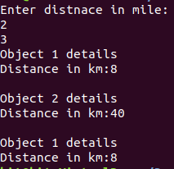
RETURNING OBJECTS

